Slide 1
Arm Development Studio

Slide 2
Learning Outcomes
At the end of this module, you will be able to:

Slide 3
Arm Development Studio overview
Notes:
We will begin this module by having an overview of Arm Development Studio.

Slide 4



Arm Development Studio featuring Keil MDK
Complete suite of tools for Arm Cortex-A/R/M based devices
Everything you need to develop Arm based projects from tiny sensors to server grade multi-core SoCs
Includes Arm Compiler 6, Debugger, Streamline performance analyzer, Mali Graphics Debugger and Fixed Virtual Platforms
Includes Keil MDK for power optimized microcontroller software development
Supports all SoC configurations: from single core to complex multi-cluster and multi-core
Investment protection
Early and dependable support for new Arm hardware IP
Used in Arm for architecture validation
Developed over many years of continuous improvement with billions of shipped products built
Technical support from the experts in Arm technology
Innovate earlier and develop faster for competitive edge
Develop software pre-silicon
Supports full development workflow from emulators to production hardware
Software building blocks for fast application development including CMSIS, middleware and RTOS
Targeted performance analysis for rapid software optimization
Earliest Arm core support
No one knows Arm better
Accelerates time to market
Notes:
What is Arm Development Studio?
Arm Development Studio is Arm’s flagship toolchain, with support for the latest Arm processors and other IP.
It comprises of:
The Arm Compiler, a mature embedded C/C++ toolchain, offering best in class performance and stability.
The Arm Debugger, an Eclipse-based debugger, developed to support Arm-based devices from the most basic to the most complex multi-core, multi-cluster configurations. The Eclipse IDE also provides project management capabilities, fully integrating the Arm Compiler.
Streamline performance analyzer – a powerful visualization tool, showing how code is executing through your system, allowing you to identify performance hotspots and other such characteristics. It can support Linux-based systems, as well as bare-metal and RTOS type systems though code annotation or hardware trace.
Development Studio also enables Keil MDK, another toolchain from Arm, also incorporating the Arm Compiler, but only targeting simpler, Cortex-M based microcontrollers.

Slide 5


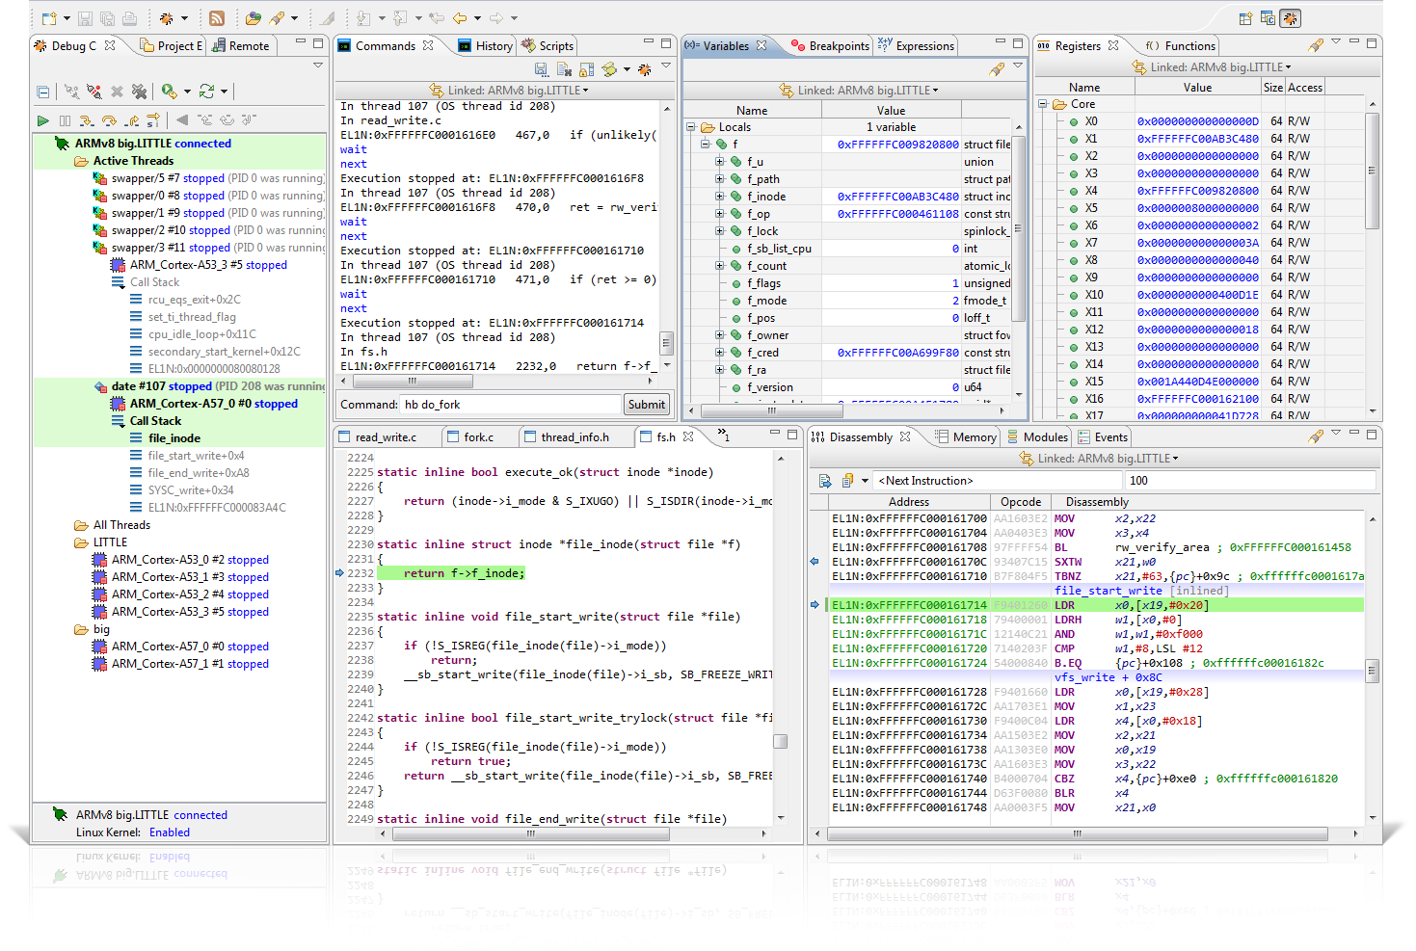

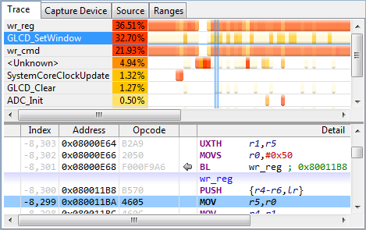
Arm Development Studio
Create & build Code
Visualize Code
Latest Arm processor support
Optimized code generation and embedded libraries
View code history up to breakpoint
View code instrumentation output
Make sense of OS level events and threads
Track GPU calls and reconstruct frame buffers
Debug Code
Inspect CPU state and execution
Set breakpoints, run scripts, debug exceptions
Cache/MMU/MPU visibility
AMP, SMP, big.LITTLE, DynamIQ
Speed Up Code
Tune code for optimal cache usage
Thread/process level visualization
GPU usage vs CPU usage
Energy use over time
Tools designed for the entire product lifecycle
Fast & Cycle Models
DSTREAM™
Family of debug hardware for FPGA & board bring-up for complex SoCs
ULINKpro D
Family of low-cost debug hardware for MCU & MPU
Virtual platforms for architectural exploration and early software development
TCP/IP
Application-level debug for BSP and reference design rollout
Notes:
The Arm Debugger is a key part of Arm Development Studio. It covers the debug (bottom left of top diagram) and code visualization (top right of top diagram) portions and extends through the entire product lifecycle – from first concept right through to finished product (shown in bottom pane).
The debugger can connect to real platforms via JTAG tools such as the DSTREAM and ULINK families of products. You can also use virtual platforms where real hardware is not available. Development Studio includes a collection of Fixed Virtual Platforms (FVPs), which, as the name implies, are ready-made complete system models, based on Arm Fast Model technology, allowing users to easily write and test software out-of-the-box.

Slide 6
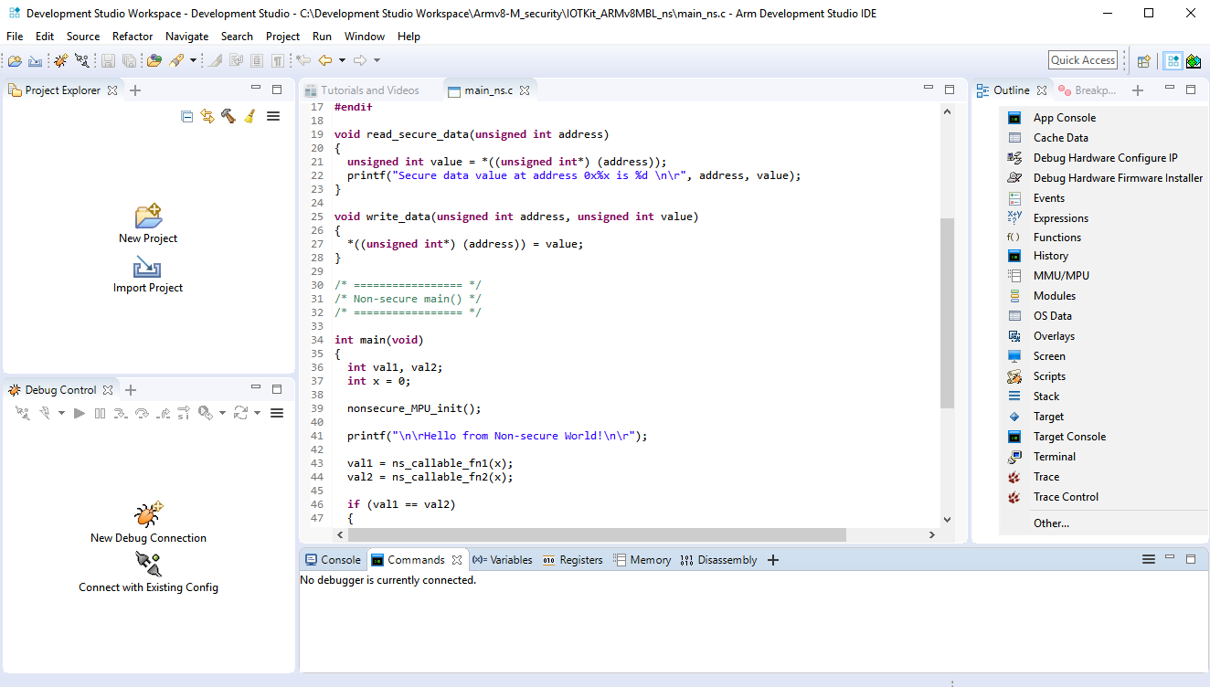
Arm Development Studio IDE
One perspective, simplified UI with easy and quick access
Quick access build buttons
Quickly add or reopen new views
Single click project\ example import
Hamburger icon (hidden menu options)
Single click debug configuration access
Quickly add or reopen new views
Notes:
The Development Studio IDE is designed for ease of use, with less menu options, and provide quick access one click buttons to create and manage projects or examples – or to launch a debug configuration.
Developer coding and debug environments are merged to allow for increased productivity without the need to switch from one perspective to another.
The IDE perspective will remember any changes a user applies to the view, and the configuration may also be saved and shared by colleagues. However it can also be reset if the user so chooses.

Slide 7

Keil MDK overview
MDK Tools
MDK-Core
Arm C/C++ Compiler
µVision IDE & debugger with pack management
With safety qualification
Software Packs
Device
CMSIS
MDK-Middleware
Startup
CMSIS-Core
Network
IPv4/IPv6
Graphics
Device HAL
CMSIS-DSP
USB
Host/Device
Mbed TLS
SSL/TLS security
CMSIS Drivers
CMSIS-RTOS
File System
IoT connectors
Probes
ULINKpro for code coverage analysis
ULINK-Plus for power optimization
ULINK2 for run/stop debugging
Notes:
As mentioned previously, Development Studio also enables Keil MDK.
Keil MDK is the most comprehensive software development solution for Arm®-based microcontrollers and includes all components that you need to create, build, and debug embedded applications.
MDK-Core is based on µVision with leading support for Cortex-M devices including the new Armv8-M architecture.
MDK includes two Arm C/C++ Compilers with assembler, linker, and highly optimize runtime libraries that are tailored for optimum code size and performance.
Software packs add device support and software components that you can use as building blocks for your application. They may be added anytime, making new device support and middleware updates independent from the toolchain. They contain device support, CMSIS libraries, middleware, board support, code templates, and example projects.
MDK Middleware provides royalty-free, tightly-coupled software components that are specifically designed for communication peripherals in microcontrollers. It is provided as part of the MDK-Professional or MDK-Plus editions in binary format. What is new is the IPv4/IPv6 networking communication stack that is extended with Arm mbed™ software components to enable Internet of Things (IoT) applications.

Slide 8
Arm Compiler 6
Notes:
We shall now learn about the Arm Compiler 6 that is included in Arm Development Studio.

Slide 9

Arm Compiler 6: Leading-edge C/C++ toolchain
The only embedded compiler you’ll ever need
Validated support for new Arm technologies significantly
Architecture validation
Developed and supported by Arm architecture experts
Efficient and accurate code for bare-metal and RTOS
Finely tuned Arm proprietary embedded libraries and linker
Optimized for a wide range of applications, not just a single benchmark
Support for the most recent language standards
Path to functional safety certification
TÜV SÜD qualified for software development to multiple safety standards
Comprehensive Qualification Kit provides essential supporting documentation
Long Term Maintenance from stable & isolated code branch
Comprehensive support
Real performance
Safety qualified
Notes:
Arm Compiler 6 is the latest version of the Arm Compiler, the proprietary embedded compiler from Arm. It is a complete toolchain, including C/C++ compiler with support for latest standards, a powerful embedded assembler, linker, and other utilities.
It comes with support for all modern Arm architectures, including leading-edge support for the newest technologies, and industry-leading optimization, which can be tuned for the best performance or code size as needed.
If developing safety-critical applications, a fully qualified version of the compiler is also available.

Slide 10
Basic armclang options
armclang -c --target=arm-arm-none-eabi -mcpu=Cortex-A9 -g -O2 foo.c
--target= selects the execution state
arch64-arm-none-eabi for v8A AArch64
arm-arm-none-eabi for v8A AArch32, Cortex-M, and Cortex-R, and older CPUs
Additionally require
-march and/or -mcpu to select specific architecture or core
-mcpu=list shows all available options (for specified target)
-On to select optimization level (0≤n≤3)
Also -Os, -Oz, -Ofast, -Omax
-O0 default (extremely poor optimization)
-flto to enable link-time optimization (implied with –Omax)
-g to enable debug info
Notes:
The box in this slide shows an example of a basic compiler command line.
The –target option is necessary to tell the compiler the type of code to generate.
Armv8 made some significant changes to the Arm instruction set and programmers model over previous versions.
From there, use the –march or –mcpu options to focus optimization towards general, or specific CPU implementations. You must specify a –target and one of –march/-mcpu to any compiler command.
Optimization can be tuned as needed. Note that highly optimized code is generally more difficult to debug.
Link-time optimization, as mentioned here, is a key optimization feature, allowing the code to be optimized across differing source files.

Slide 11
Basic armlink options
--cpu= selects the CPU (or architecture)
Mainly used as a check when merging projects
--scatter to specify scatter description file
Defines platform memory map
--entry to specify entry point (symbol or address)
--lto Link-Time Optimization (armclang objects built with -flto)
Notes:
The linker is used to bring all the compiled source objects together, and to locate the code and data in accordance to the platform memory map.
A scatter description file is used to define this memory map to the tool.
The entry point is where code execution begins and allow the linker to determine if there is code in your project that is never used, as well as by the debugger to understand where to begin from.

Slide 12
Arm Compiler 5 (armcc)
Legacy compiler, no longer in development
No support for any Armv8 architectures
However 20+ years of history, many projects exist based on this compiler
Recommend all projects start with (or migrate to) Arm Compiler 6 (armclang)
Thorough migration documentation available
For many users, C/C++ source code will simply be directly portable
Changes only to command options
armcc source containing embedded assembler must be re-written to GNU assembler (gas) format
Recommend rewriting with compiler intrinsics
Notes:
Arm Compiler 6, also known as armclang, is the latest and recommended version of the compiler.
However the older compiler, commonly known as armcc, is no longer being developed. armcc has been in use for a long time (20+ years), and so there is a lot of code available based on this compiler.
For many users, migrating code to the newer compiler should be trivial, however if they have complex code, including embedded assembly, or other advanced coding, thorough documentation is available.

Slide 13
Debug and trace
Notes:
We will now look into the debug and trace features supported by Arm Development Studio.

Slide 14
Arm Debugger key points
Full support of Arm IP
Arm Debugger is developed alongside Arm IP
Support for all Arm cores, including leading-edge support for cores that are not yet public
Comprehensive support for all Arm debug and trace IP
Flexible architecture
Support for target complexity, challenging implementations, non-Arm IP
Extension APIs – customize debugger functionality, integrate with other tools
Designed for productivity
Integrated with Eclipse and Python – both widely used
Debugger views and functionality optimized for fast, efficient, and clear operation
Advanced bring-up tools, expert support world-wide
Comprehensive scripting support with shallow learning curve
CMSIS-Pack compatibility
Notes:
Developed internally by Arm, based on Eclipse technology, the Arm debugger is a powerful tool for developing with any Arm-based platform.
Arm Debugger comes with support for 500 complex devices out-of-the-box, as well as 6000+ microcontrollers via software packs, and the ability to auto-detect and configure for an arbitrary Arm system. Powerful low level bring up tools are also provided for those users doing initial silicon validation.
The tool is fully scriptable for automation and testing use cases.

Slide 15
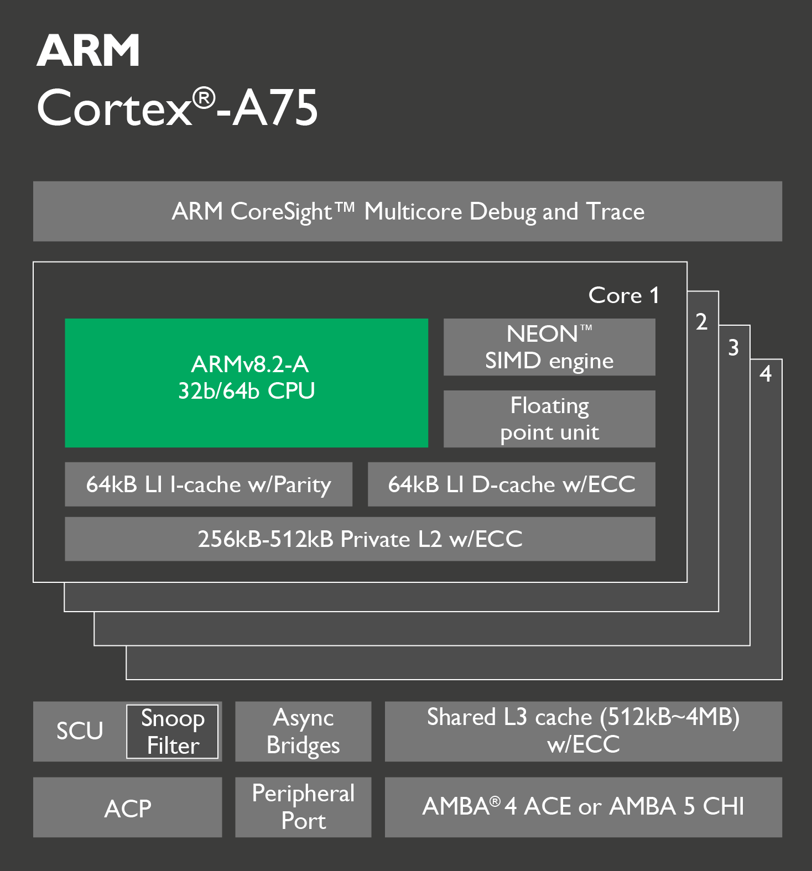
Comprehensive support for Arm cores
Arm Development Studio is developed alongside Arm cores
Debug support for cores and architectural extensions is developed as soon as it is practical
Development Studio is used as part of the normal core development and validation process
Debugger testing is carried out against Fast Models and early FPGA implementations of all Arm cores
Tools available for leading-edge partners working with future cores which are not yet public
Notes:
For early, validated, support of new Arm cores, Development Studio provides a reliable and low-risk solution. Supporting Arm IP is a key requirement of the Arm Debugger – Arm has to support new cores as soon as it is practical to do so. Support is phased in as the core design matures: basic debug at an early stage, followed by advanced features like MMU and cache visibility as this work becomes possible. Development Studio core support can be tested against early implementations long before silicon becomes available.

Slide 16
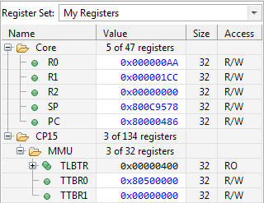
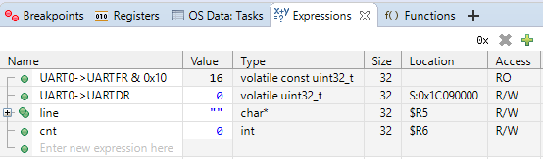
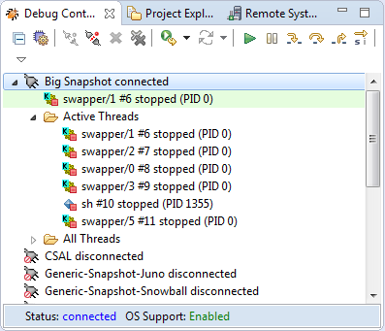
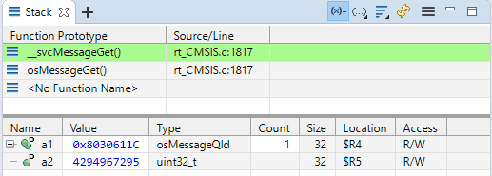
Advanced User Interface Design
Simplicity, visibility, and performance
Notes:
<This slide has animation – it has three builds to show/hide four panes. Click mouse to advance through build>
For a complex debug target, a debugger faces challenges. It needs to display all the information that the users need to make fast decisions, but this can bring confusion (as too much information is displayed), delays and frustration (as the user has to hunt to the information needed) and slow debugger performance (as excessive information is read from the target).
Arm Debugger views are designed to overcome these challenges, and show exactly the information that the user needs (but nothing extra). The result is a clear, easy to use debugger, with excellent performance and easy to find information. This slide shows examples of the various views.
The top left shows custom register sets, you can create a custom register view displaying exactly the registers you need.
The top right shows the expressions view, where it displays calculations.
The bottom left shows the stack view, with parameters types and values passed to function(s).
The bottom right shows the debug control view, which displays critical information by default such as information about non-scheduled threads can be expanded if needed.

Slide 17
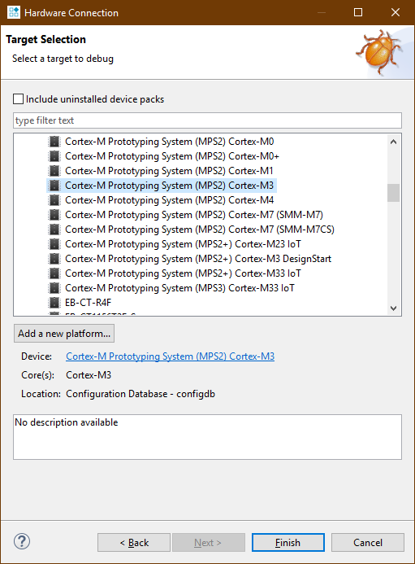
Target connection configuration
Hardware and models connection wizard
Select device, board or FVP easily
Recently used list
Add new platform if device not listed
Creates a new configuration with the platform configuration editor
Configuration wizard generates an initial debugger configuration based on device information.
Notes:
Wizards to connect to hardware and models takes care of complex target configurations, and simplifies the connection setup. Recently used devices enable quick access and reuse of previous configurations.
Within this wizard, new platforms can be easily configured and included to the list.

Slide 18
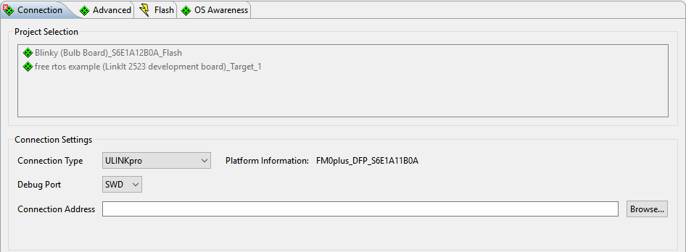
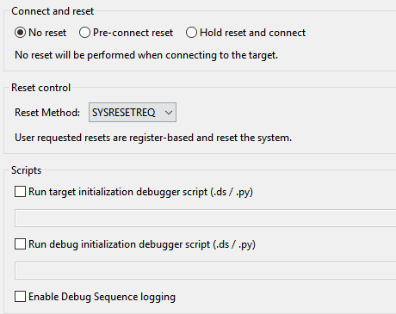
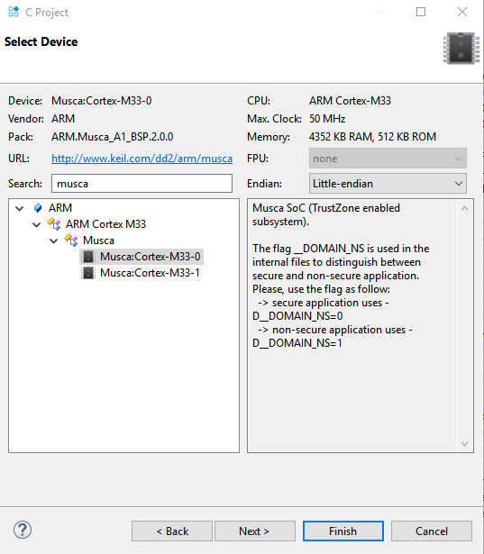
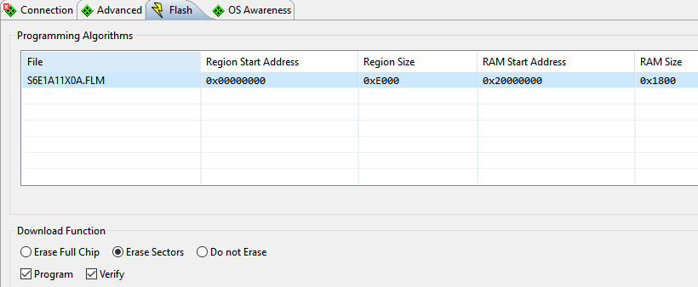
Debugger configuration with software packs
Device selection based on packs
Advanced target connection, reset options
Flash programming with support for multiple flash regions
Notes:
The software pack debug configuration wizard allows advanced target and debug probe connections, including connect, reset and flash programming configurations.

Slide 19
Trace – how it works
CPU instruction execution history via ETM
Data load and store (certain CPUs)
Instrumented trace (ITM, STM)
Arm trace data collected in
On-chip CoreSight trace buffer (ETB, ETF, ETR)
Off-chip debug probe via physical trace port on the target
Rotating trace buffer fills in the background during a debug session
When a breakpoint is hit the content of the trace buffer is displayed
Notes:
Most Arm devices support some from of trace functionality.
The Embedded Trace Macrocell (ETM) goes alongside an Arm processor to monitor instruction execution, as well as data accesses on certain processors.
The Instrumented Trace Macrocell (ITM) and more general System Trace Macrocell (STM) allow users to implement largely non-intrusive printf style diagnostic output from their application.

Slide 20
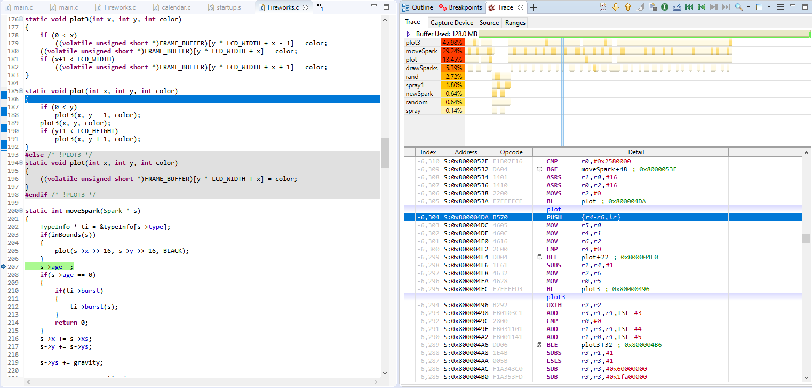
Trace view in Arm Debugger
A non-intrusive ‘flight recorder’ for your system
Per-CPU timeline shows order of execution and indicative function profile
Source code highlighting,
synchronized with Trace view
Reconstructed instruction trace
Notes:
Collecting Arm CPU trace (ETM or PTM) enables Arm Debugger to reconstruct instruction-by-instruction the history of your program as it was executed by the CPU. This is similar to flight recorders or hidden CCTV systems, in that the CPU trace is entirely independent (non-intrusive) and can capture all relevant data to allow to follow all steps of your program in order to quickly investigate unexpected behavior.

Slide 21
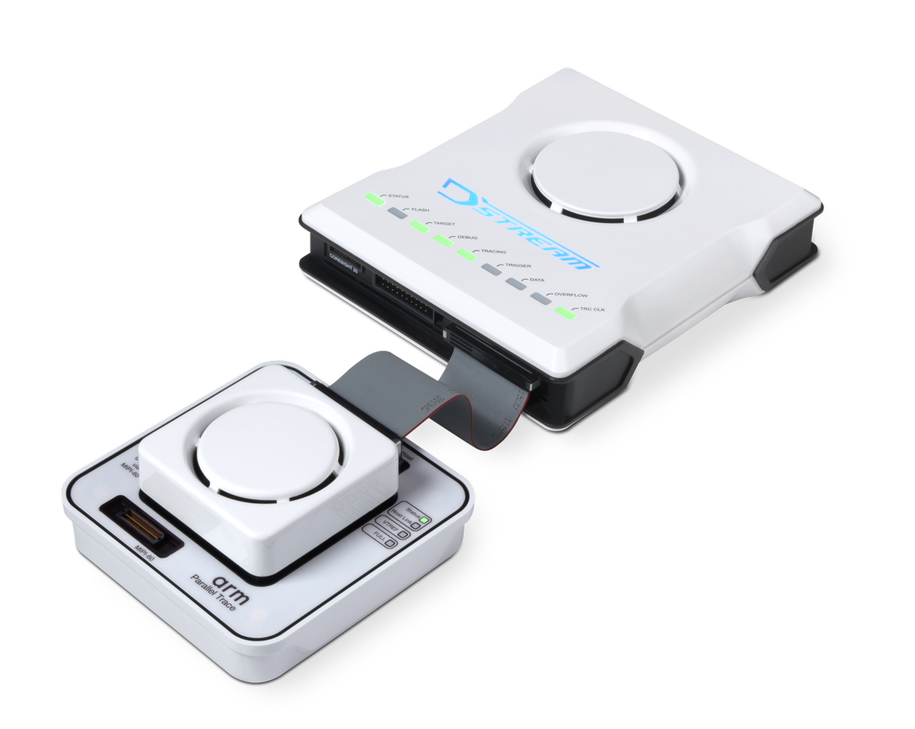
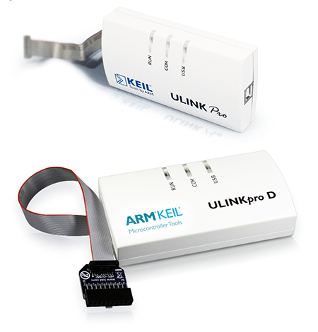
Debug probes
Range of probes to match your requirements
Notes:
This slide shows the high-performance DSTREAM family of debug adapters and the low-cost ULINK family, allowing the user to connect the Arm debugger to real hardware (development boards etc).
For more information, see https://developer.arm.com/tools-and-software/embedded/debug-probes
Note that these are sold separately from Development Studio.

Slide 22
DSTREAM-ST family
Second-generation debug and trace probes
New design featuring patented technology to address the needs of modern SoC’s
Capabilities | DSTREAM-ST | DSTREAM-PT | DSTREAM-HT
JTAG / SWD | 180 / 125 MHz | 180 / 125 MHz | 180 / 125 MHz
Download speed | Up to 12MB/s | Up to 12MB/s | Up to 12MB/s
Maximum CoreSight components | 1022 | 1022 | 1022
Parallel trace pins | 1 - 4 | 1 - 32 | 1 - 4
High-speed serial trace |  |  | Yes
Maximum trace bandwidth | 1.6Gb/s | 19.2Gb/s | 60Gb/s
Host connectivity | USB 3.0 Gigabit Ethernet | USB 3.0 Gigabit Ethernet | USB 3.0 Gigabit Ethernet
On-probe trace store | Stream to host only | 8GB | 8GB
Notes:
Note: DSTREAM-ST and DSTREAM-PT are second-generation probes from Arm. Together they replace and improve on the capabilities of the first-generation probe DSTREAM, which after stock runs out in summer 2019 will no longer be manufactured – but will continue to be supported in Arm Development Studio.
DSTREAM-HT is used with systems that support High-Speed Serial Trace Probe (HSSTP), a method of outputting trace using fewer pins than normal.

Slide 23
ULINK family
Simplicity
Just select a supported platform from the database and connect
Consistent debugging experience across probes
Cost efficiency
Perfectly engineered to meet basic debug needs
Supported by both Keil and Arm Development Studio tools to protect your investment
Notes:
The ULINK family of probes is simple, low-cost probes, ideally suited for microcontroller type targets. Though ULINKs can be used for certain cases, if using a high-end platform, especially one with multiple processors, DSTREAM family is generally recommended.

Slide 24
Virtual platforms
Notes:
We will now look at the virtual platforms included in the Arm Development Studio.

Slide 25
Virtual prototyping solutions
Fast Models
Instruction accurate, suitable for software development and test
Cycle Models
Timing accurate models, derived from actual RTL
Fully validated models of Arm IP
Collection of Fixed Virtual Platforms (FVP) provided with Development Studio
Complete system models based on Fast Model technology
Notes:
Arm offers two classes of virtual prototyping technology, which are:
Fast Models, and
Cycle Models.
These models enable users to create systems before or in lieu of real hardware being available.
Development Studio includes a collection of Fixed Virtual Platforms (FVP), which are ready-made platforms for various processors, including multi-core configurations, based on Fast Model technology.

Slide 26
Virtual prototype solutions
Faster
Arm Fast Models and FVPs
Programmer’s view
50-200 MIPS
Simulation speed
Arm Cycle Models
Cycle accurate
1-20 KIPS
Detailed Abstraction level Abstract
Notes:
Arm produces Cycle Accurate models (Cycle Models) derived from RTL and hand-written Fast Models derived from the architecture and CPU specification. Both models are extremely accurate as the Cycle Models are derived from that actual RTL implementation and the Fast Models run the same validation suites as the RTL. The difference between these types of models is the level of abstraction, with impacts the simulation speed and the ability to correlate execution with real time.
Cycle Models will give you 100% accuracy at the expense of execution speed, however, there are several techniques that can be used to trade off accuracy for execution speed.
Fast Models with Timing Annotation - TLM 2.0 supports the annotation of time to transactions. Fast Models Timing Annotation allows the user to apply timing information to think like CPI per instruction class, cache and TLB accesses, branch prediction penalties, etc. Early results indicate that 80% accuracy is achievable and work is ongoing to improve this further.
Swap & Play – Run part of the simulation in Fast Models and then switch to Cycle Model (i.e. cycle accurate) simulation at any breakpoint. Improves overall simulation time. Level of improvement will depend on how much of the simulation is run on Fast Models versus Cycle Models.
Pure Virtual Hybrid – Mixes Fast Model and Cycle Model simulation, where part of the design is rendered in a Fast Model and part in Cycle Model. This is different from Swap & Play in that you aren’t switching simulation states within the same model. Not only does it speed up simulation time, but also allows co-simulation with non-Arm IP.
Hybrid with Emulation – Combines the performance of Virtual Prototypes with the accuracy of Emulation. Run part of the simulation on the Fast Model and the remainder on an emulator (e.g. Cadence Palladium, Mentor Veloce, Aldec HES, Synopsys HAPS). Improves overall simulation time. Level of improvement will depend on how much of the simulation is run on Fast Models versus emulator. Not only speeds up overall runs, but helps avoid capacity issues when designs don’t fit within the emulator.

Slide 27
Arm Streamline performance analyzer
Notes:
We will now look at the Arm Streamline performance analyzer, which is included in Arm Development Studio.

Slide 28
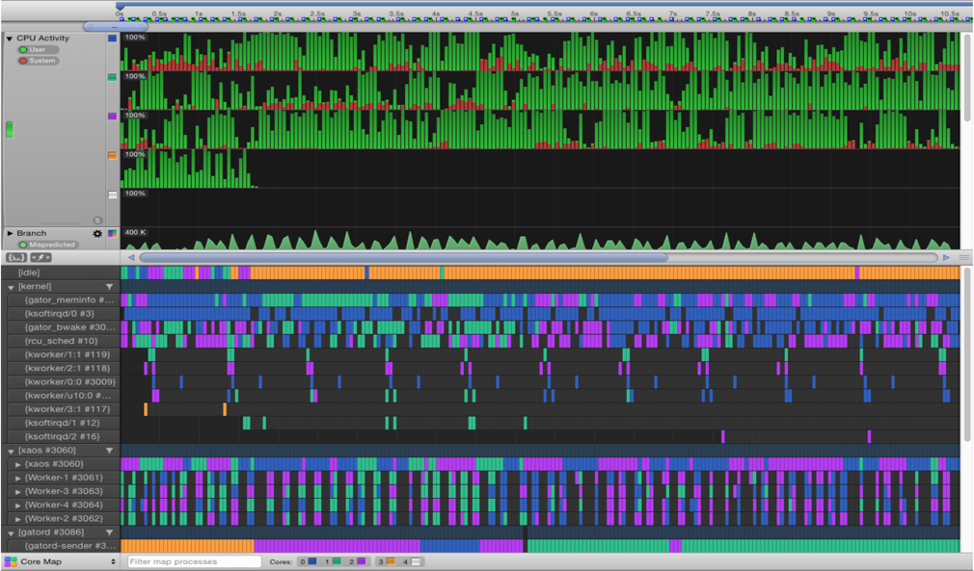
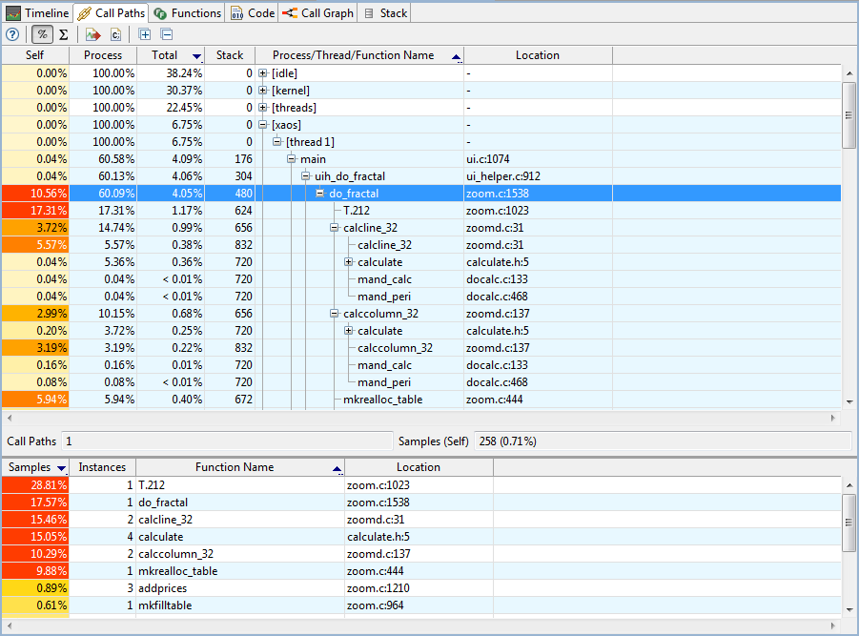
Speed Up Your Code
Arm Streamline
Performance Analyzer
Find out where the CPU is spending the most time
Tune code for optimal cache usage
OpenCL™ Visualizer
Visualization of OpenCL dependencies, helping you to balance resources between GPU and CPU better than ever
Drill down to the Source Code
Break performance down by function
View it alongside the disassembly
Mali GPU Support
Optimize energy efficiency
Customize it for Your System
Analyze and optimize Mali™ GPU utilization
Monitor CPU and GPU cache usage
Monitor actual power consumption with the Arm Energy Probe
Correlate software execution to actual power consumption
Flexible architecture permits easy addition of new counters
Open-source driver and daemon gives developers ultimate flexibility
Notes:
Arm Streamline allows you to visualize code execution to ensure efficient and optimal performance.
It can be used for Linux applications, in conjunction with a kernel module known as gator, as well as bare-metal and RTOS applications by instrumenting the code or making use of ETM trace history.
Streamline can be used with both real and virtual platforms.

Slide 29
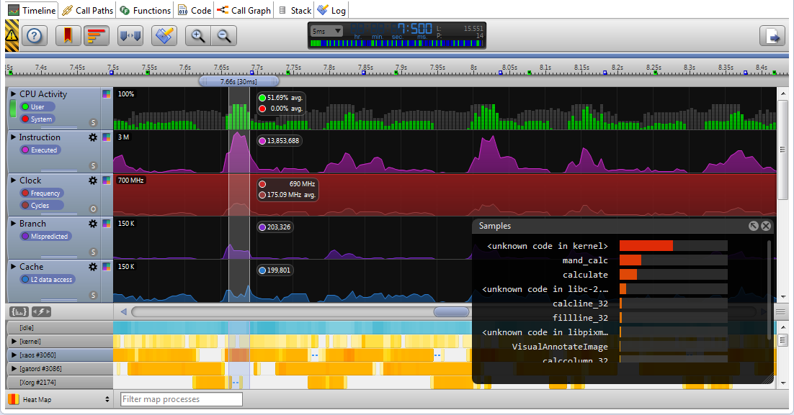
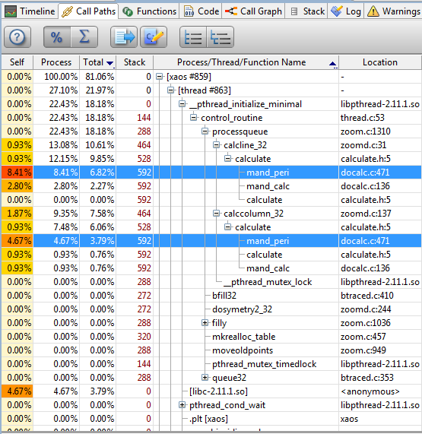
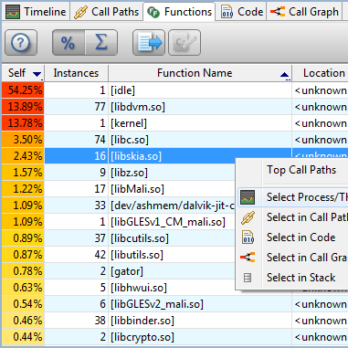
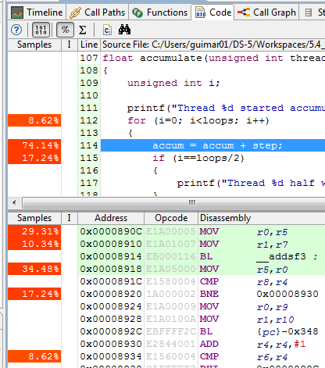
Process to Success
Timeline
Call Paths
Functions
Code
Log
Visualization of system performance metrics, software profile and system events over time
Hierarchical profile table, aggregating samples per process, thread, and function call chain
Flat software profile table, listing shared libraries and function hotspots
Source and instruction level profile. Color coded source code lines for easy identification
Chronologic list of text and graphic user annotations sent to Streamline, offering flexible filtering
Notes:
The tool allows you to deep dive into code execution to help the user tune their code for their target hardware.

Slide 30

We invite you to try it out for yourself
For more information see arm.com/development-studio
Notes:
In summary, the Arm Development Studio comprises various features that support software development for the latest Arm processors and IPs.
A fully featured 30-day evaluation license is available from the Arm website.

